Slide 1
Car Accident Severity Prediction
Submitted by: Omar Salameh
Date: October 1, 2020

Slide 2
Introduction
The Washington State Department of Transportation Crash Data Portal provides crash information for accidents that occurred state-wide. According to the 2019 data, there were 45,524 accidents on all roads. Of those:
235 were fatal crashes
973 were suspected of serious injury accidents
2,798 were suspected of minor injury accidents
9,412 were possible injury crashes
32,106 were no apparent injury collisions
Our motivation is to use the weather, location and road condition data provided in the dataset, made available by the Seattle Department of Transportation Traffic Management Division, to arrive at a correlation to predict the severity of road accidents. This tool/data can then be made available to the public and the Seattle traffic authorities to possibly prevent/reduce severe or fatal accidents in the future by taking precautionary measures.

Slide 3
Data Collection
The dataset used for this project is based on car accidents which have taken place within the city of Seattle, Washington from the year 2004 to 2020. This data is regarding car accidents the severity of each car accidents along with the time and conditions under which each accident occurred. The data set used for this project can be found here.

Slide 4
Methodology
Exploratory Data Analysis
Considering that the feature set and the target variable are categorical variables with the likes of weather, road condition and light condition being an above level 2 categorical variables whose values are limited and usually based on a particular finite group whose correlation might depict a different image then what it actually is.
A few pictorial depictions of the dataset were made in order to better understand the data.
The below figure illustrates, after data cleaning has taken place, the distribution of the target variables between Physical Injury and Property Damage Only. As it can be seen that the dataset is supervised but an unbalanced dataset where the distribution of the target variable is in almost 1:2 ratio in favor of property damage.

Slide 5
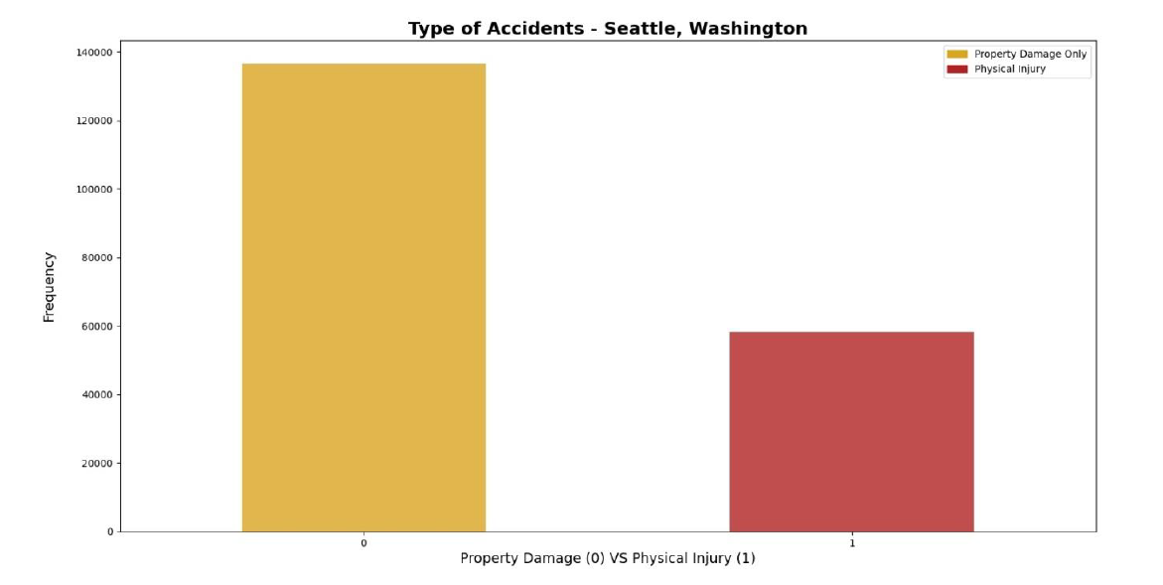

Slide 6
Methodology
Data Processing
Removal of irrelevant columns or features - Columns containing descriptions and identification numbers that would not help in the classification are dropped from the dataset to reduce the complexity and dimensionality of the dataset. 'OBJECTID', 'INCKEY', 'COLDETKEY', 'REPORTNO', 'STATUS', 'INTKEY', 'EXCEPTRSNCODE' and more belong to this category. Certain other categorical features were removed as they had a large number of distinct values, example: ‘LOCATION’.
Identification and handling missing values - To identify columns and rows with missing values is the next step. Empty boxes, ‘Unknown’ and ‘Other’ were values considered as missing values. These were replaced with NA to make the dataset uniform.
Balancing the dataset - With the above two pre-processing steps complete, a dataset (143747 rows) with 94821 rows for severity code 1 and 48926 rows for severity code 2 is obtained. Training an algorithm on an unbalanced dataset w.r.t the target category will result in a biased model. The model will have learnt more about one the category that has more data. In order to prevent this, a new balanced dataset (97852 rows) is created by randomly sampling out 48926 rows with severity code 2 and then concatenating it with 48926 rows with severity code 1. The dataset is then shuffled to randomize the rows.

Slide 7
Data Processing Contd. –
Encoding of data - Machine Learning models are trained only on numerical data; hence all categorical features in the dataset have to be encoded so that the algorithms can be trained on those features. The ‘get_dummies’ method from pandas library is used to convert/encode each and every categorical feature.
Splitting into training and testing datasets - The datasets X and Y are split into X_train, Y_train, X_test, and Y_test. The first two will be used for training purposes and the last two will be used for testing purposes. The split ratio is 0.8, 80% of data is used for training and 20% of is used for testing.
Understanding Correlation in Dataset - Finding the correlation among the features of the dataset helps understand the data better. For example, in the below figure (correlation plot using matplotlib), it can be observed that some features have a strong positive/negative correlation while most of them have weak/ no correlation.

Slide 8
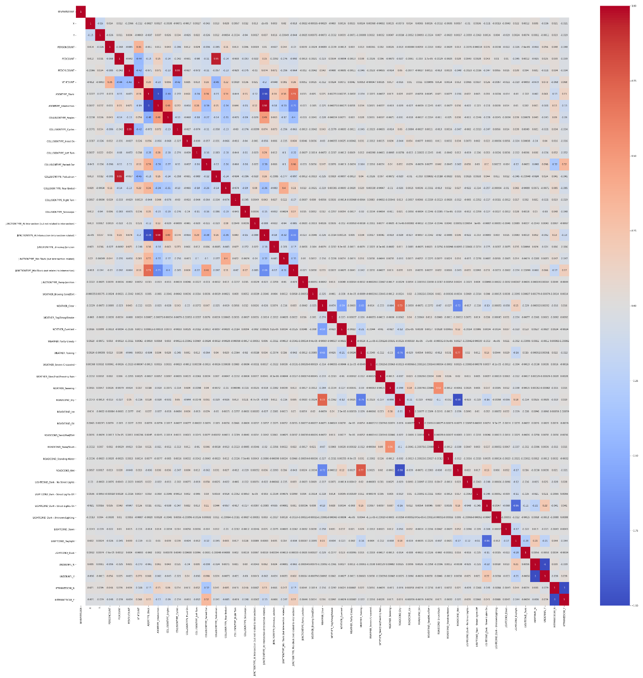

Slide 9
Machine Learning Model Selection
Total of six ML algorithms were trained on the pre-processed dataset and their accuracies were compared. A brief explanation on how each of them works along with their results in shown below.
Logistic Regression Classifier
K Nearest Neighbors Classifier
Naïve Bayes Classifier
Decision Tree Classifier
Random Forest Tree Classifier
Support Vector Machine Classifier

Slide 10
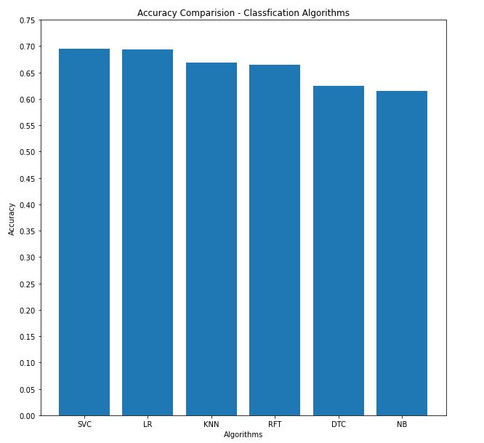
Results
These models can predict the severity code of an accident with an accuracy equalling 60-70%
A bar plot is plotted below with the bars representing the accuracy of each model in descending order respectively.

Slide 11
Conclusion
The accuracy of the classifiers is not great, highest being 69%. This usually means that the model is under fitted i.e. it needs to be trained on more data. Though the dataset has a lot of variety in terms of scenarios, more volume of the data for such scenarios has to be collected.
Certain features with missing values were removed, this reduced the dimensionality of the dataset, these features could have been correlated to other important features but they had to be removed. A better effort has to be made to collect data to reduce the number of missing values.

